Slide 1



@enjenneer
@SecurityCRob
Securing Open Source Software - End-to-end, At massive scale, Together
Jennifer Fernick - SVP & Global Head of Research, NCC Group
Christopher Robinson (aka CRob) - Director of Security Communications, Intel
August 5 2021
#BHUSA @BlackHatEvents
Notes:
JF?
Welcome to….
My name is Jennifer Fernick and I am the Global Head of Research at NCC Group. I am joined by my colleague Christopher Robinson who serves as the Director of Security Communications at Intel.

Slide 2
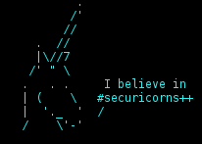
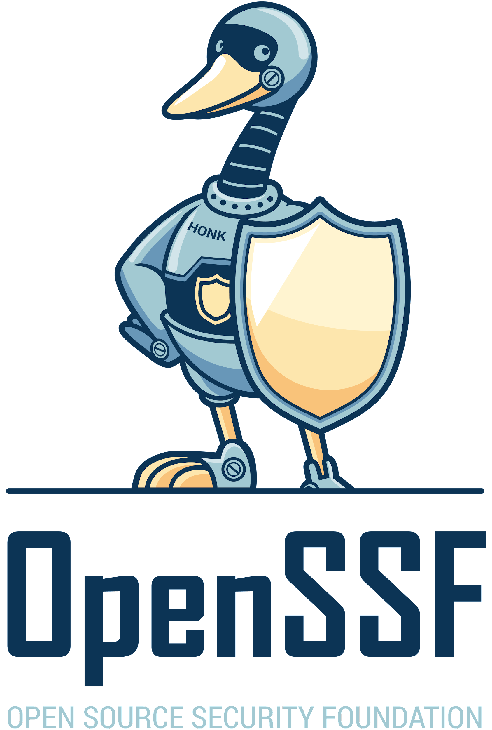
In this talk:
About us
Lessons learned from the last 20 years of coordinating OSS vulnerability disclosure
Why securing the open source ecosystem matters
Securing OSS at scale has several unique challenges
Threat modelling the open source ecosystem
Why the insecurity of the open source ecosystem is accelerating
Reducing vulns at scale / what actually helps / coordinated approach / OpenSSF
Q&A
Notes:
JF
In this presentation we’ll be speaking about securing the open source ecosystem
To begin, we will share a bit about us - myself from the perspective of both a security researcher as well as of someone who, in a past life, designed and ran cryptographic systems in production that protected tens of billions of dollars in daily transactions, and CRob from the perspective of someone who helped coordinate the vulnerability disclosures of some of the most impactful vulnerabilities in our industry over the past 7-8 years.
Lessons learned from the last 20 years of coordinating OSS vulnerability disclosure
Why securing the open source ecosystem matters
Securing OSS at scale has several unique challenges
Offer a threat model of the open source ecosystem, (because securing OSS is wayyy more than preventing malicious commits)
Why we believe that the insecurity of the open source ecosystem is accelerating based on things like
Speed at which new vulns are exploited ITW
Increased use of supply chain attacks
Advances in computer science making exploitation easier than ever
And we will finally, discuss:
Techniques for reducing vulns at scale,
explain the status quo for coordinated work to improve the security of open source, and
Share how the Open Source Security Foundation is scaling the efforts of security researchers to amplify our impact, as well as how to get involved in openSSF and access a range of resources to support this important work
Q&A
coordinating the industry-wide remediation of some of the most impactful vulnerabilities ever disclosed (Heartbleed, Shellshock, Rowhammer, and BlueZ)
Heartbleed -started it all
World relying on a really powerful package with 1.5 ppl supoprting it
LF stepped in and OpenSSF is the descendants of that
What we’ve learned from all of this
Value of community and working with each other - one org doesn’t have all of the talent to fix it
Mutual respect
earning this respect and finding good solutions through allowing good ideas
Meritocracy - stressful and lots of debate and pressure from customers/govt/bad guys
Securing Critical Projects
the things the internet depends on isn’t funded by many
lack of a consortia or govt or whatever making it happen
and open source isn’t even that
but security incentives dont really make it happen
“millions of silent passengers” with no way of understanding things downstream - this is a failure of modern development - not holding devs/product managers accountable
and even OpenSSF ppl like us are doing it as a side project - and this is where the funding helps
How much of the world’s software uses OSS? 60-90%
this is amazing
Mapping transitive dependency risk
how many ppl contribute to the kernel of something
thousands of devs in the linux kernel but there is one that does NTP
tracing out what would happen “if these 3 things broke, what does the world look like”
NTP, Apache, etc - things used by every web service - foundational ones
Could use the list from OSTIF
Top 20 critical projects
number of core devs in openssl
vulns being exploited in the wild and us not even knowing about it
Badges, dashboards, risk ratings, other openssf projects
Also: thinking about vulns in OSS getting worse and why this is going to get even worse over time
Free software isn’t free - you need to give some kind of cost/risk/etc or you have to wait etc

Slide 3


[us@bh.usa ~]$ ./HelloWorld.sh
Jennifer Fernick
SVP & Global Head of Research at NCC Group
Co-founding Governing Board/TAC member for the Open Source Security Foundation
Prev: Cryptographer (quantum cryptanalysis, post-quantum cryptography, cryptographic standards development, cryptographic architecture)
Prev: Director of Information Security at a major FI
Grad school: CS; Engineering (Waterloo); undergrad: Artificial Intelligence (Toronto)
CRob, n, adj, and v
Pronunciation: U.S. (K-robe)
Over 25 years of Enterprise-class Architecture, Engineering, Operations, and Security experience
Ambassador For Intel Product Assurance and Security
Working Group lead for the OpenSSF Dev Best Practices & Vuln Coordination WGs, FIRST PSIRT TPC WG, and others
Co-Author FIRST PSIRT Services Framework & others
Pirate-enthusiast & hat-owner
The thoughts and feels expressed here are personally held or experientially earned, and not necessarily those of our employers
Notes:
JF, CR
Jennifer Fernick
SVP & Global Head of Research at NCC Group
Co-founding Governing Board/TAC member for the Open Source Security Foundation
Prev: Cryptographer and quantum computer scientist
I also previously was a security architect and later led the security team at a large global bank
My academic background is in quantum computing, systems engineering, and artificial intelligence

Slide 4
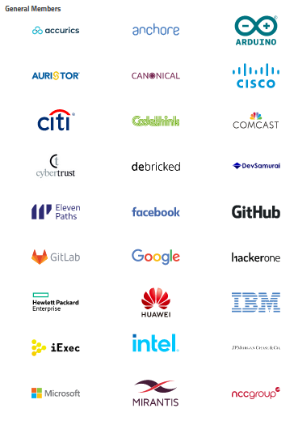
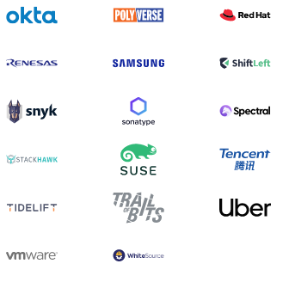

openssf.org
Notes:
JF/CR?
[We’re sharing lessons from openssf but not speaking for particular member companies]

Slide 5
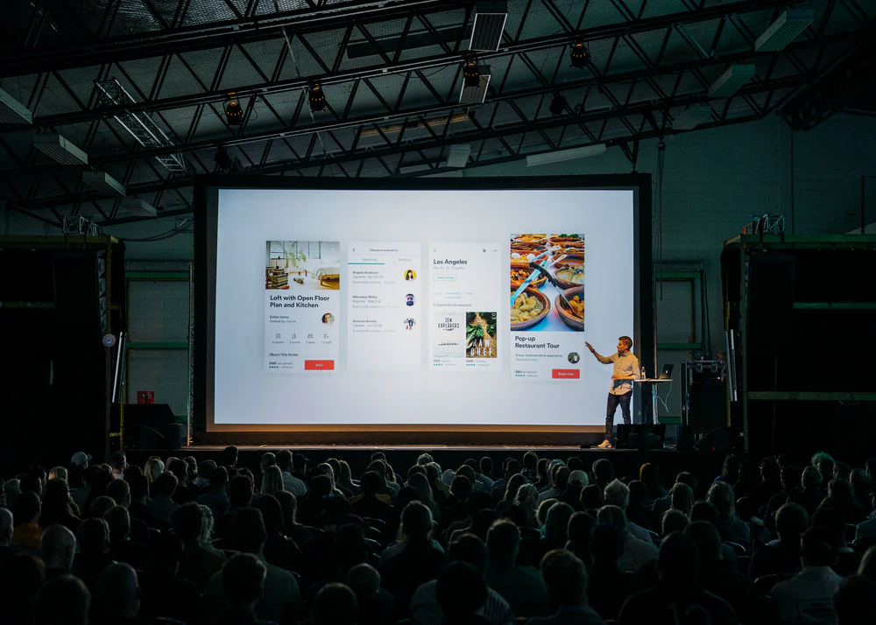






"He emailed me and said he wanted to maintain the module, so I gave it to him," developer Dominic Tarr wrote in a GitHub comment. "I don't get anything from maintaining this module, and I don't even use it anymore, and haven't for years."
Imagine a World….
11/26/2018 - Ars Technica - Widely used open source software contained bitcoin-stealing backdoor
https://images.unsplash.com/photo-1567427018141-0584cfcbf1b8?ixid=MnwxMjA3fDB8MHxwaG90by1wYWdlfHx8fGVufDB8fHx8&ixlib=rb-1.2.1&auto=format&fit=crop&w=1050&q=80
https://images.unsplash.com/photo-1586769852351-8791d2bb43be?ixid=MnwxMjA3fDB8MHxwaG90by1wYWdlfHx8fGVufDB8fHx8&ixlib=rb-1.2.1&auto=format&fit=crop&w=634&q=80
https://images.unsplash.com/photo-1586282023617-b844c180eb51?ixid=MnwxMjA3fDB8MHxwaG90by1wYWdlfHx8fGVufDB8fHx8&ixlib=rb-1.2.1&auto=format&fit=crop&w=1050&q=80
https://images.unsplash.com/photo-1497465541860-77f114a519d2?ixid=MnwxMjA3fDB8MHxwaG90by1wYWdlfHx8fGVufDB8fHx8&ixlib=rb-1.2.1&auto=format&fit=crop&w=1050&q=80
https://images.unsplash.com/photo-1584677123777-742161156eb7?ixid=MnwxMjA3fDB8MHxwaG90by1wYWdlfHx8fGVufDB8fHx8&ixlib=rb-1.2.1&auto=format&fit=crop&w=1050&q=80
https://images.unsplash.com/photo-1612251485013-58be9e5689c3?ixid=MnwxMjA3fDB8MHxwaG90by1wYWdlfHx8fGVufDB8fHx8&ixlib=rb-1.2.1&auto=format&fit=crop&w=1053&q=80
https://images.unsplash.com/photo-1505373877841-8d25f7d46678?ixid=MnwxMjA3fDB8MHxwaG90by1wYWdlfHx8fGVufDB8fHx8&ixlib=rb-1.2.1&auto=format&fit=crop&w=1000&q=80
Notes:
CR
historical examples where vulnerabilities in open source components have had large-scale impact? istoical examples wherevulnerabilities in open source components have had large-scale impact?
Historical examples / disclosure - incident handler at Red Hat, coordinating internal and external for patching these issues
Heartbleed
BlueZ / Rowhammer
Shellshock
Spectre / Meltdown
Historical coordinated disclosure stories - Crob did a panel at BH
Heartbleed -started it all
World relying on a really powerful package with 1.5 ppl supoprting it
LF stepped in and OpenSSF is the descendants of that
What we’ve learned from all of this
Maybe this is salient
Spectre was a cluster - Intel messed it up and learned from it
Value of community and working with each other - one org doesn’t have all of the talent to fix it
Mutual respect
earning this respect and finding good solutions through allowing good ideas
Meritocracy - stressful and lots of debate and pressure from customers/govt/bad guys
Bluetooth is abandoned and need sw and hw ppl all collaborating and competing prior
Can you point us to some historical examples where vulnerabilities in open source components have had large-scale impact?

Slide 6

CVE-2014-0160
https://heartbleed.com/
Vulnerability in popular open source library OpenSSL that could leak sensitive information otherwise thought protected by SSL/TLS encryption
This is a widely-used method to protect communications over TCP-IP-based networks (example - The Internet)
”At the time of disclosure, some 17% (around half a million) of the Internet's secure web servers certified by trusted authorities were believed to be vulnerable to the attack, allowing theft of the servers' private keys and users' session cookies and passwords” ⁽⁷⁾
Public disclosure - 7 April 2014
Exposure -
21 June 2014 - 309,197 public web servers remained vulnerable ⁽⁸⁾
6 July 2017, the number had dropped to 144,000 ⁽⁹⁾
11 July 2019, 91,063 devices were vulnerable ⁽¹⁰⁾
(7) - Heartbleed
(8) - 300k vulnerable to Heartbleed two months later
(9) - Heartbleed’s Heartburn: Why a 5 year Old Vulnerability Continues to Bite
(10) - Heartbleed Report
At the time, OpenSSL had TWO full-time developers to develop, maintain, test, and review 500,000 lines of code ⁽⁷⁾
Notes:
CR

Slide 7
Why does securing the open source ecosystem matter?
The Security of OSS = The Security of EVERYTHING
Notes:
CR

Slide 8
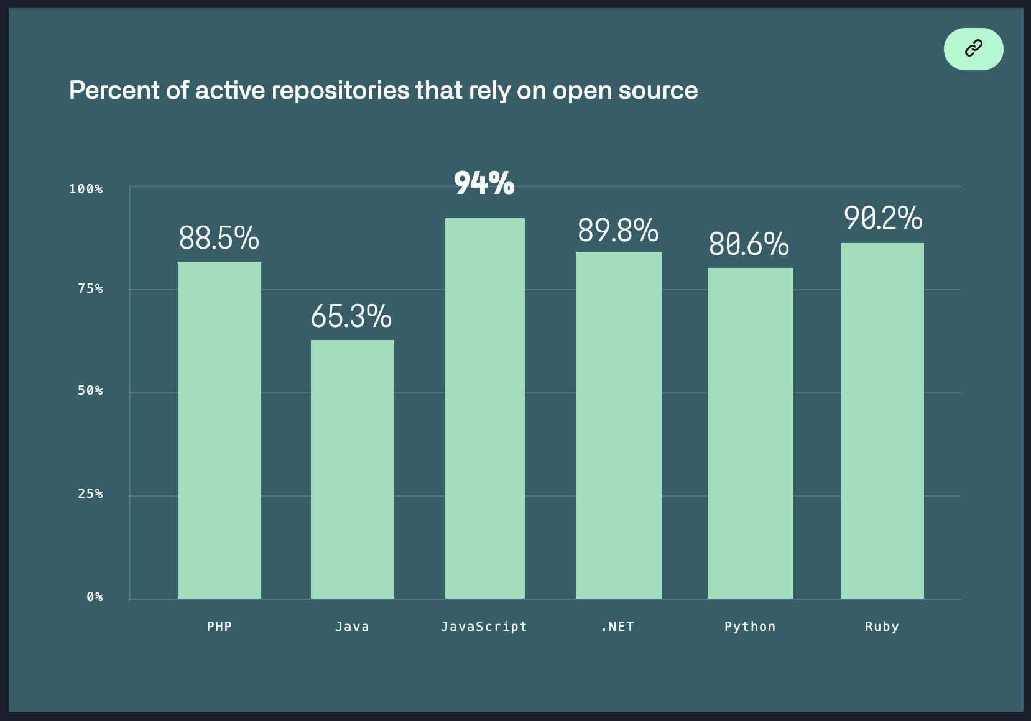
Problem Overview - Securing the open source ecosystem
It has been estimated that FOSS constitutes 80-90% of any given piece of modern software ⁽¹⁾
One report found that 84% of these codebases had at least one vulnerability, with the average having 158 per codebase ⁽²⁾
Other reports discover that average applications contain 118 libraries with roughly ⅓ being active; The average library age was 2.6 years old ⁽³⁾
Over a 10 year period the volume of vulns has increased over 4 times [as measured with CVE] ⁽⁴⁾
Most OSS vulns are discovered in indirect dependencies ⁽⁵⁾
A typical vuln can go undetected for 218 weeks, and typically takes 4 weeks to get resolved once the project is alerted to it ⁽⁶⁾
(1) - State of the Software Supply Chain
(2) - 2021 Open Source Security and Risk Analysis Report
(3) - 2021 State of Open Source Security Report
(4) - 2020 Red Hat Risk Report
(5) - 2020 State of Open Source Security Report
(6) - 2020 State of the Octoverse
Image - %Rely on OSS
Notes:
CR? Source for chart, “Percent of active repositories that rely on open source”: https://octoverse.github.com/#chart-rely-on-oss (data from “This analysis included public open source repositories with at least one contribution in each month between 10.1.2019 and 09.30.2020.”)
Why does securing the open source ecosystem matter?
Open source software is a significant part of the core infrastructure in most enterprises in most sectors around the world, and is foundational to the internet as we know it. Consequently, it represents a massive and profoundly valuable attack surface. The Heartbleed vulnerability in OpenSSL disclosed in April 2014 showed us what this risk looks like in practice - a single critical vulnerability, found within an individual open source project maintained by only a few volunteers, compromised the security nearly one-fifth of the webservers on the internet.
In 2019, over 16000 vulnerabilities were disclosed and assgned CVE numbers across proprietary and open source software, and over 1000 of those were scored “critical”. Vulnerabilities are not rare. We need to systematically reduce them, especially in widely-used software. We also need to better understand the threat landscape for open source projects, and help make security easier or default whenever possible, so we can reduce the risk of developers focussing on the features that they care about most.
“According to Gartner over 95% of the IT enterprises across the globe use open source software (OSS) for their mission-critical IT workloads, whether they are aware of it or not.” (source: https://github.com/readme/featured/octoverse-security)

Slide 9
Challenges of Securing Open Source Software at Scale
Notes:
JF?
JF: “FREE SOFTWARE ISN’T FREE - we make tradeoffs in terms of security debt for differences between project realities and our security intentions, as well as risk-related tradeoffs in terms of the extent to which a project is maintained, security-tested, and able to respond to vulnerability reports or security incidents. This is not to say that the security of open source software is worse than that of closed-source software, but rather, that the way we handle it is unique.
The truth is, like most software CHANCES ARE that YOU’RE GETTING A PENTEST, WHETHER YOU PAID FOR IT OR NOT”
And so, let’s go into more detail about the unique security challenges of the open source ecosystem

Slide 10
What makes OSS a unique target for adversaries?
Many of the best things about open source development invite unique security challenges:
Deobfuscated and public-facing source code lowers attacker barrier to entry
Distributed community-driven development with contributions from unknown third-parties
Tragedy of the commons regarding security analysis
Lack of consistently-deployed security standards, reviews and tooling
(Often) decreased capacity for vulnerability remediation
Lack of resources for monitoring & typical underpreparedness for incident response
Different economic incentives & feedback loops than: enterprise devs; threat actors
In spite of this: many high-value targets, foundational to enterprises and the internet itself
Notes:
What makes open source software a unique target for adversaries?
What makes open source so impactful, is also what makes it difficult to secure.
Deobfuscated and public-facing source code as opposed to proprietary/closed source software for which an attacker must reverse engineer the binaries
Distributed community-driven development, where contributions come from many sources including, at times, unknown third-parties
At times, a “tragedy of the commons” where we assume that software is secure because anyone could have looked at it and found bugs - but we’re not actually assured, in many cases, that anyone has
A lack of consistently-deployed security standards, reviews and tooling, resulting in weaknesses at various points in the SDLC, even where “easy wins” for security, such as listing vulnerability disclosure contact information, is not present.
In many cases, decreased capacity for vulnerability remediation, and even worse incident response, particularly in smaller projects or in those without a mature security program.
Entirely different economic incentives and allocation of human and financial resources compared to industrial software development, where security is often not incentivized or accounted for, as well as compared to threat actors
But in spite of all of this, high-value targets that are foundational to many of the technologies that power our world and to the internet itself.

Slide 11
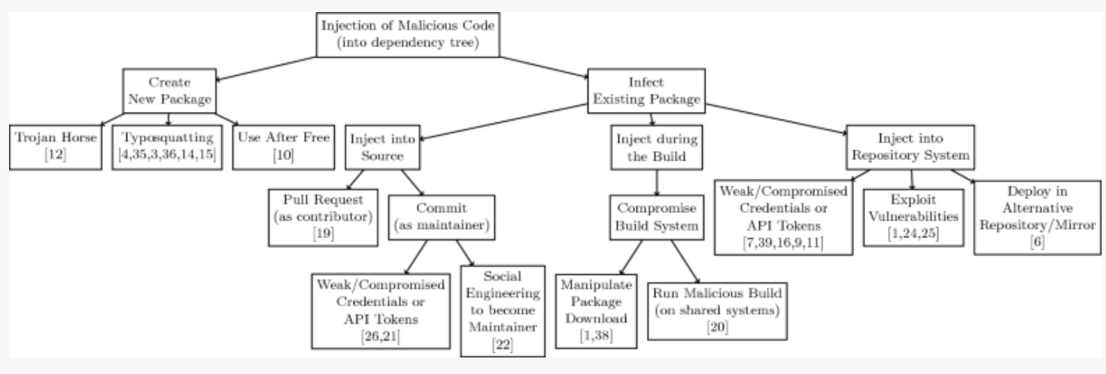
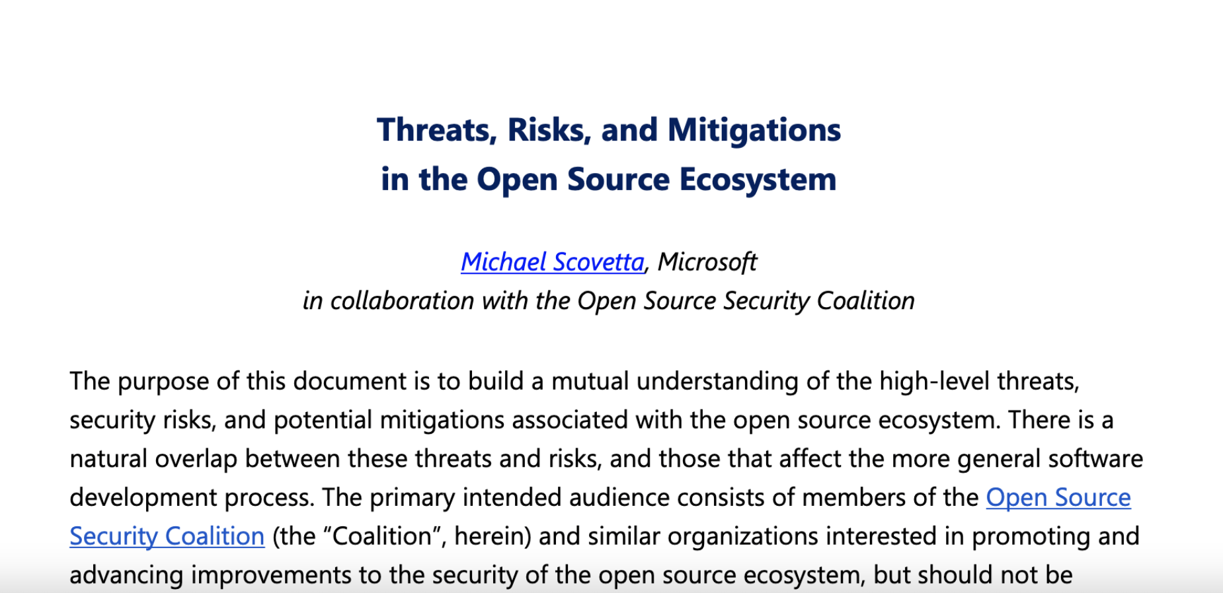
OSS security is about more than just vulnerabilities in source code
Source: Backstabber’s Knife Collection: A Review of Open Source Software Supply Chain Attacks (2020)
Notes:
When threat modelling OSS, we have a broad attack surface that begins before any code is written, and extends to every individual developer’s local machine and network, all the way through the broader project infrastructure, and beyond into the package management ecosystem
Concept phase
Think about intrinsic risk related to your entire tech stack
Focus on areas of enhanced risk - cryptography & secrets management, OS kernels, etc
Local development on maintainer’s machine in the interest of making malicious commits to a repo, or to preview forthcoming changes or otherwise exfiltrate information
have seen examples of malware which sought to exfiltrate a devs npm access tokens
as well as the XcodeGhost supply chain attack in 2015 in which malicious versions of Apple’s Xcode development environment were distributed
Infrastructure / Project level
Mistakes in code:
Copy-pasting insecure code from stackoverflow
Using insecure development practices
Committing secrets to source code or packages
Abuse of debug privileges and development-related backdoors by threat actors, and other abuses by external contributors
External contributors who may introduce malicious code, either independently or through compromise of a legitimate developer’s contirbutions
Compromises to - or insufficiently robust pairing between - developer identity and authentication
Insecure CI/CD pipelines in which a range of attacks can occur; compromises of build systems
There has been great work around Build pipelines and verification, including work around reproducible builds and binary transparency
Problems amplified by a Lack of build pipeline security tooling: static analysis; fuzzing
Lack of platform security, OS-level protections, and runtime protecions
Package Ecosystem
Typosquatting to insert malicious packages
Direct compromise of legitimate packages
Use of malicious dependencies
Vulnerability disclosure
Inaccurate security contact
Unmaintained project
Maintainer does not see the bug as a security vulnerability, or is unable to write the patch
Insecure communications methods, including projects’ desire for vulnerabiities to be reported as public issues
Patching in public may allow RE in advance of forthcoming patches to infer not-yet public vulnerabilities
I would direct the interested listener to the “Threats, Risks, and Mitigations in the Open Source Ecosystem” published by Michael Scovetta of Microsoft and several collaborators from OpenSSF. https://github.com/ossf/wg-identifying-security-threats/blob/main/publications/threats-risks-mitigations/v1.1/Threats%2C%20Risks%2C%20and%20Mitigations%20in%20the%20Open%20Source%20Ecosystem%20-%20v1.1.pdf

Slide 12
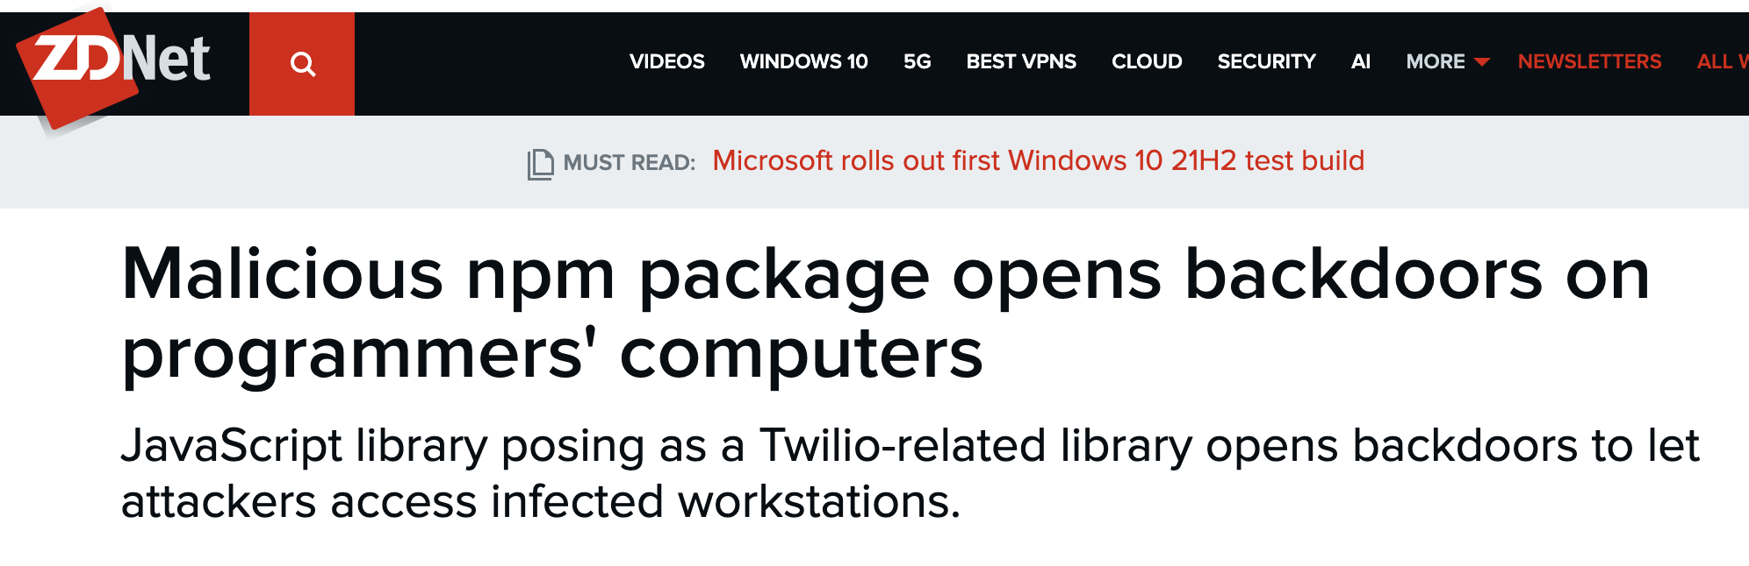
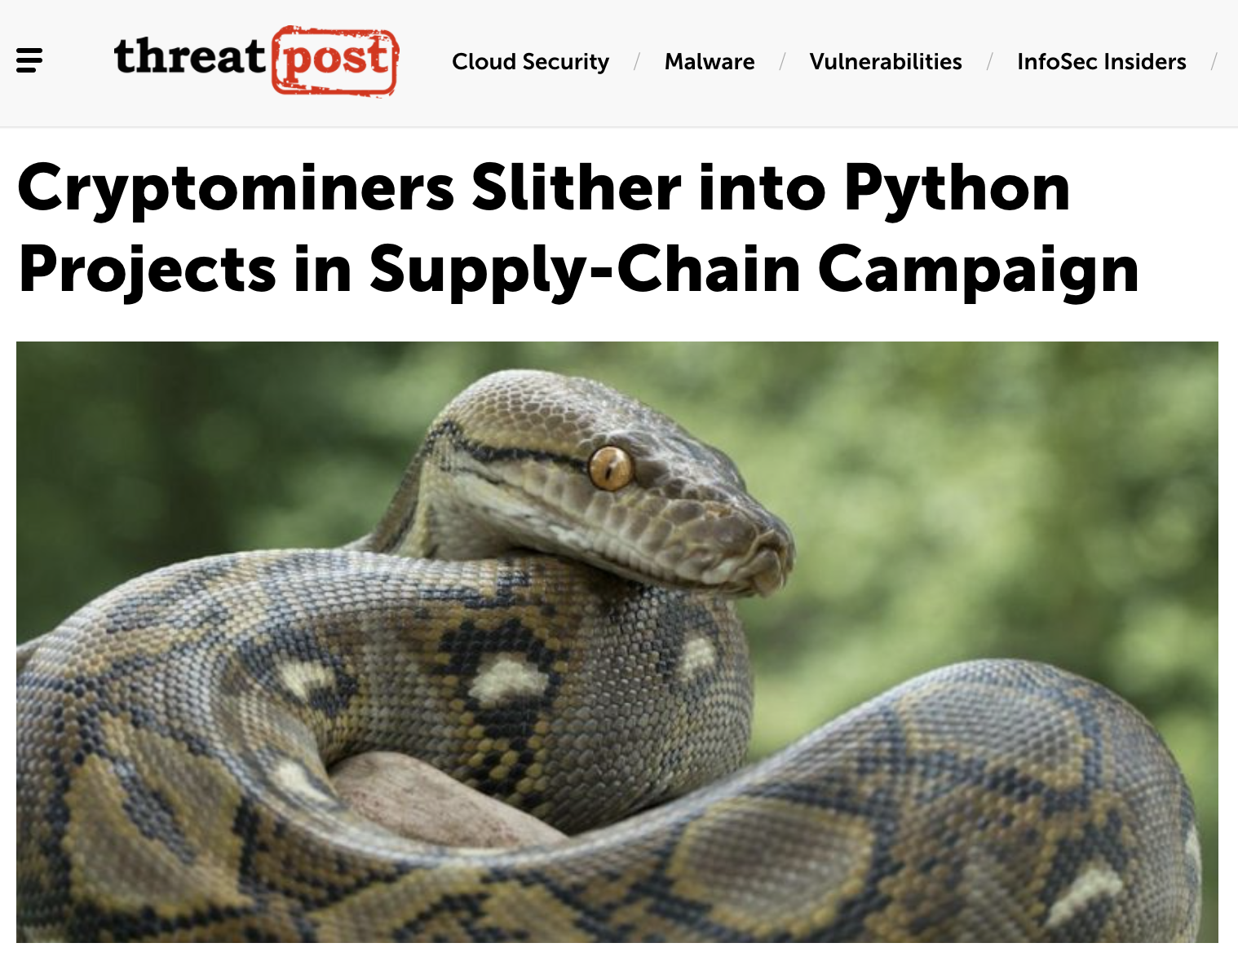
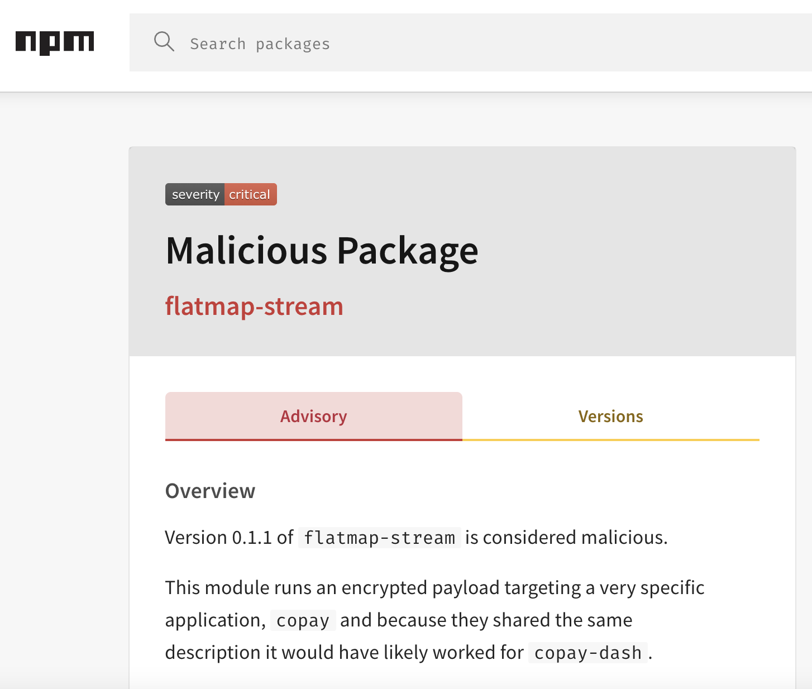
Vulnerabilities in the Open Source Ecosystem
Notes:
JF/CR?
https://threatpost.com/cryptominers-python-supply-chain/167135/
Spicy malicious package example: https://www.npmjs.com/advisories/737

Slide 13
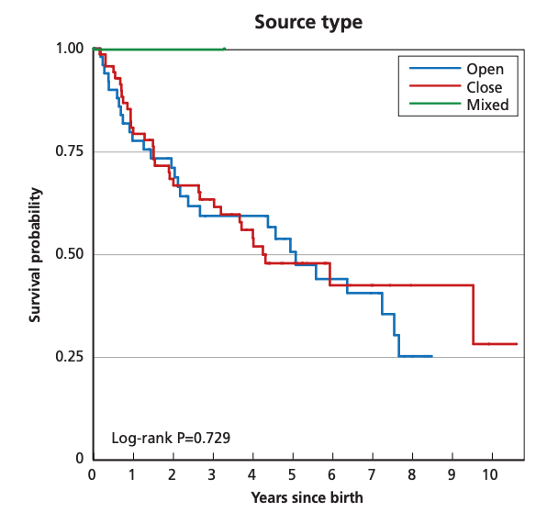

Open source security keeps getting worse &
it’s no one’s fault, but it’s everyone’s problem
Source: RAND Corporation, “Zero Days, Thousands of Nights” g
Years to detect: A typical vulnerability on GitHub goes undetected for over 4 years (>2.5y for critical)
Mere days to exploit: Days between vulnerability disclosure and exploit creation has gone from 45 days to 3
Devs are not getting better at secure coding: “A line of code written in 2020 is just as likely to introduce a security vulnerability as one written in 2016” - GitHub
Applications are increasing in complexity & transitive dependency risk seems to be growing
Notes:
JF
Ultimately, open source security keeps getting worse
On average, it takes YEARS to detect a typical software vulnerability in open source software.on average, a vulnerability on GitHub goes undetected for over 4 years - even critical vulnerabilities took over 2.5 years to get disclosed. From there, it takes over a month for the average disclosed vulnerability to have a fix released by an open source project, and when downstream patches are released, less than a third of them are applied within a month of release. Sometimes impactful vulnerabilities in high profile libraries aren’t found for many years - for example, the vulnerability that came to be known as Shellshock was found in Bash 22 years after it was committed.
What’s more, exploitation in the wild is happening faster than ever before. This is true for both open source and proprietary software.
“According to the 2019 State of Software Supply Chain report,.. the number of days between vulnerability disclosure and exploit creation has shrunk from 45 to 3”
SAP reported earlier this year that it takes, on average, 72 hours after a patch is released for the vulns to be weaponised (source: https://www.theregister.com/2021/04/06/sap_patch_attacks/ )
In our own research at NCC Group, we monitored exploitation of …..
While many of these attack examples are for proprietary software, they paint the picture of bigger trends that apply to OSS as well. Threat actors don’t care what licenses your code has. It was found that exploitation of vulns in open source ITW do not die off faster than those in proprietary software, and that this finding has also been replicated by other researchers. (Source for “Source type” graph above: https://www.rand.org/content/dam/rand/pubs/research_reports/RR1700/RR1751/RAND_RR1751.pdf)
It seems that developers are not actually getting better at secure coding.
Github “ran CodeQL, GitHub’s static analysis security tool, on each commit to several thousand popular open source projects over a five year period to see if the rate at which vulnerabilities are introduced has changed over time...” and they had not: “a line of code written in 2020 is just as likely to introduce a security vulnerability as one written in 2016”
We also know that the number of CVEs across open source projects in the NVD more than doubled between 2018 and 2019.
What amplifies this problem is that these CVEs likely only represent a small proportion of the vulnerabilities sitting in open source codebases today - …..
Applications are growing in complexity over time
Data from Synopsos shows that the average number of components in an application over the last three years has gone from 298 to 445 to 528 (source: Synopsys, cited in https://venturebeat.com/2021/04/13/synopsys-84-of-codebases-contain-an-open-source-vulnerability/)
Software complexity derives in part from an increase in direct and transitive dependencies, which compounds as there are more links and more dependencies per link in the dependency chain. It also makes security tooling less effective in finding vulns (because tools tend to fall off in performance compared to human pentesters as the difficulty of detection becomes increasingly abstract across a broader codebase)
Source for image “4 Years, 4.4 weeks….” : https://octoverse.github.com/#chart-rely-on-oss)
Data to show this (weave in from google doc; possibly figure out some new things illustrative around transitive dependencies)
Why?
People don’t seem to be getting better at not introducing vulns (metrics)
Software is getting more complex with greater transitive dependencies (metrics?)
PoC exploits are being seen faster in the wild than they used to be (metrics?)

Slide 14
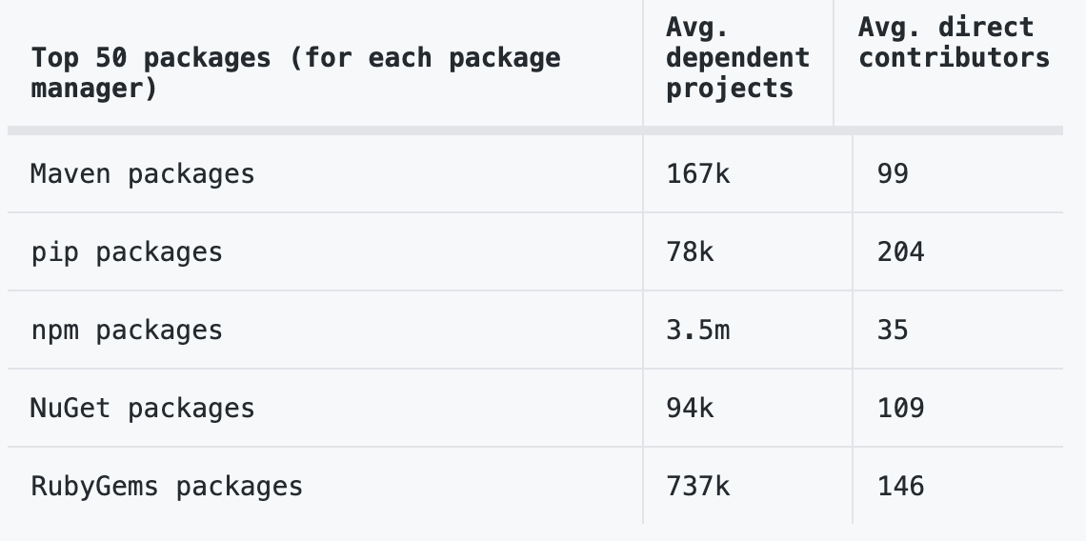


Open source projects have an average of 180 package dependencies
The top 50 OSS projects with the most downstream dependencies had an average of 3.6 million projects dependent upon them
Source: Github State of the Octoverse 2019
Vulns in OSS have been central to major breaches and some of these vulns were not found until decades after their creation
Vulns in your code
Vulns in your code’s code
Notes:
Let’s talk about transitive dependency risk. Even if your code is free of vulnerabilities, your code likely depends on something which itself is full of vulns. Vulns on vulns. Vulns all the way down
Open source projects have an average of 180 package dependencies. But this number can range from just a few packages to more than 1,000. (source: Github State of hte Octoverse 2019)
The 50 open source projects with the most dependent projects each had an average of 3.6M+ dependents. This data is based on content from manifest files in public repositories with open source licenses. (Source: Github State of the Octoverse 2019)
CVE-2017-5638, a vulnerability in the open source Apache struts framework, was exploited in the breach of Equifax, which resulted in the unauthorized disclosure of 200,000 credit card numbers (source: https://debricked.com/blog/vulnerabilities-dependencies/)
npm package event-stream attack: The alleged attacker was givenownership of this popular npm package simply by asking the original developer to take over its maintenance. This was a package used by 1,600+ other packages, and was downloaded 1.5 million times a week on average (source: https://link.springer.com/chapter/10.1007%2F978-3-030-52683-2_2)
Oh, and these things arent always quickly remediated - Shellshock existed in bash for 22 years before it was found

Slide 15
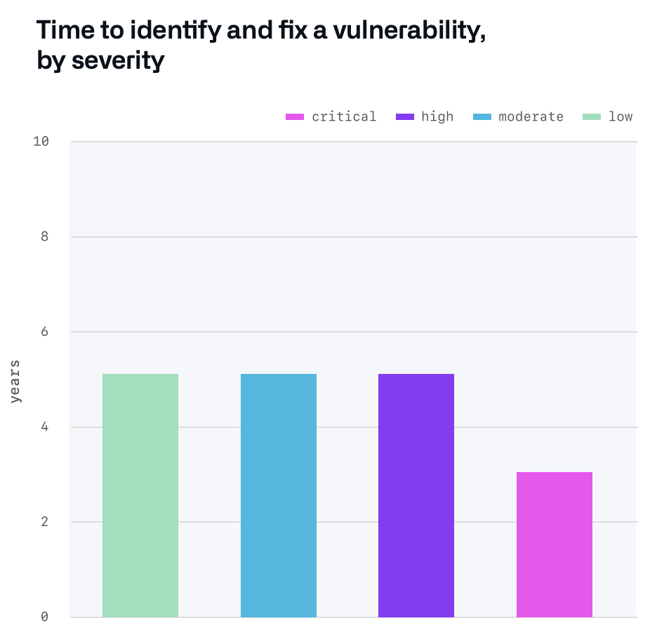
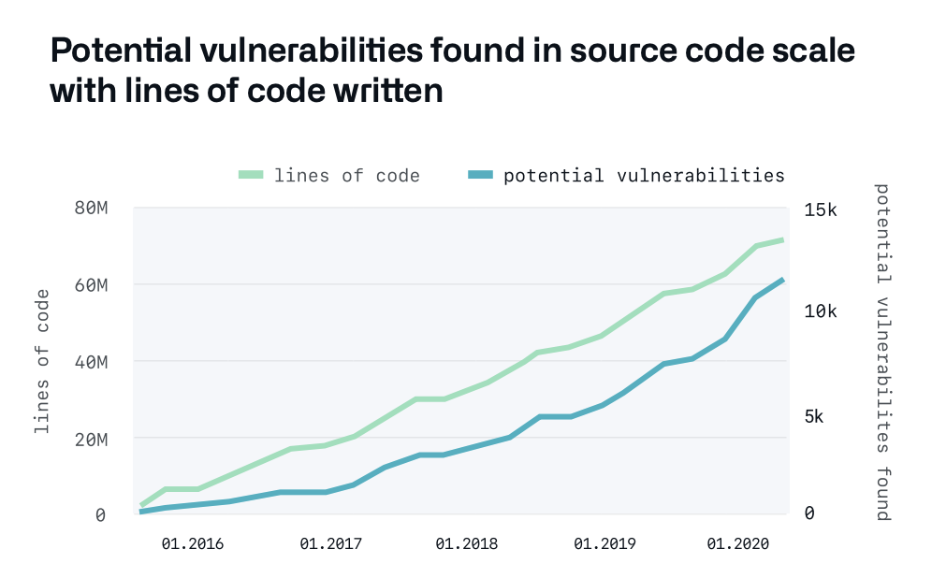
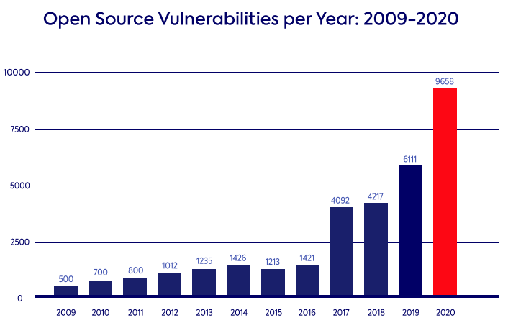
The number of vulnerabilities “in the wild” outpaces the speed at which the security community can patch or even identify them. And each day, the world contains more lines of source code than it ever has before
Source: Github State of the Octoverse 2020
Source: Github State of the Octoverse 2020
Source: Whitesource State of Open Source Security 2021
Vulnerabilities seem to scale with lines of code - but other metrics besides LOC show similar patterns
The number of reported vulnerabilities in open source codebases is growing each year
Every year, more lines of OSS are written than ever before, but vuln detection lags years behind
+
=
Notes:
JF every year, we write more lines of source code than ever before. For example,
In 2020, 60 million new repos were created on GitHub, with around 1.9 billion contributions.
Vulnerabilities seem to scale with lines of code - but other metrics besides LOC show similar patterns
We also see that The number of reported vulnerabilities in open source codebases is growing each year - and furthermore, we have reasons to believe that the number of vulns being reported is radically lower than the total number of exploitable vulnerabilities in the wild.
“Open Source Vulnerabilities per Year: 2009-2020” graph sourced from: https://www.whitesourcesoftware.com/resources/blog/2021-state-of-open-source-security-vulnerabilities-cheat-sheet/
“Potential vulnerabilities found in source code scale with lines of code written” graph sourced from Github 2020 State of the Octoverse security report: https://octoverse.github.com/static/github-octoverse-2020-security-report.pdf

Slide 16
The creation of potentially exploitable vulnerabilities increasingly outpaces the rate at which we can search for and remediate them, and this problem is one that only gets worse with time.
Security as it is practiced now does not scale. And we have reasons to believe this will only get worse for defenders.
Notes:
JF
So we might ask ourselves, “If we stay on our current trajectory, will the security of open source software get better, or worse?”
Without serious and coordinated intervention, it will get worse. The number of vulnerabilities “in the wild” outpaces the speed at which the security community can patch or even identify them. And each day, the world contains more lines of source code than it ever has before. Consequently, the [generally inadvertent] creation of potentially exploitable vulnerabilities increasingly outpaces the rate at which we can search for and remediate them, and this problem is one that only gets worse with time.
So, we already have this problem that security as it is practiced now doesn’t scale at the rate needed to keep things at least as secure as they were yesterday. What’s worse is that we have compelling reasons to expect this to get even worse for defenders.

Slide 17
Economics of patching vs exploitation benefit threat actors over defenders
Threat actors don’t care about CFAA
Increased transitive dependencies over time in OSS projects
Decreasing time to exploitation of vulns in the wild
Threat actors don’t need multi stakeholder coordination
Notes:
JF
So, in this slide I’d like to make two points, firstly and briefly about the status quo imbalance between attackers (specifically: threat actors) and defenders, and secondly a most interesting point about how any gains for defenders actually benefit attackers as well.
So, the first point is that the economics of exploitation for threat actors offer a considerable advantage to them compared to the economics of patching for defenders, especially for open source software.
Threat actors do not generally care about things like policy or law
Unlike patching, exploiting OSS does not require multi-stakeholder coordination
Threat actors ARE incentivized to successfully exploit vulnerabilities, In contrast, security researchers are NOT generally incentivized to write patches
Threat actors’ #1 priority is to successfully exploit vulnerabilities, In contrastt, open source maintainers #1 priority is the core functionality of their project (not writing or applying patches)
In addition to this, the economics of OSS compared to closed source software differ: While enterprise, proprietary software comes with certain expectations of software maintenance and security, open source is “at your own risk” with the understanding that the developers of these codebases may not have the same goals, threat model, or priorities as you
As a result of all of these interrelated factors, we see a decreasing length of time between vulnerability discovery and exploitation, as well as between vulnerability patching and exploitation. [BUT, THERE ARE EVEN BIGGER REASONS TO WORRY]
Data to show this (weave in from google doc; possibly figure out some new things illustrative around transitive dependencies)
Why?
More and more lines of code (metrics?) - CR said there were 4x CVEs over the last 20 years - but lots of unfound things and chaining of things
People don’t seem to be getting better at not introducing vulns (metrics)
Software is getting more complex with greater transitive dependencies (metrics?)
PoC exploits are being seen faster in the wild than they used to be (metrics?)
Mayhem, CGC, findings on AEG, ML-driven PoCs (but not a silver bullet)
Data to show this (weave in from google doc; possibly figure out some new things illustrative around transitive dependencies)
W
People don’t seem to be getting better at not introducing vulns (metrics)
Software is getting more complex with greater transitive dependencies (metrics?)
PoC exploits are being seen faster in the wild than they used to be (metrics?)
But we’re just struggling as defenders on “how do I email the person who wrote this library”
Copilot shows
I think we have yet to see the true potential of techniques for finding vulnerabilities at scale. Large-scale fuzzing projects, vulnerability discovery query languages such as CodeQL, innovations in program analysis, applications of machine learning to identifying examples of particular bug classes, and recent research in automated exploit generation (AEG) have yet to, in my opinion, become fully realized, and are likely to shift the security landscape.
What’s simultaneously exciting and terrifying is that the technologies that can be used to hunt vulnerabilities at scale are dual use in nature - they can be used by the defenders, or they can be used by our adversaries. The challenge in this is the truism that defenders have to be right every time, whereas attackers only have to get it right once.

Slide 18
Uncomfortable truth: Scalable vuln-finding helps adversaries, too
Economics of patching vs exploitation benefit threat actors over defenders
Innovations in program analysis
Advancements in automated exploit generation
Large-scale fuzzing projects; vuln discovery query languages
Machine learning advancements in generative language, including code
Threat actors don’t care about CFAA
Increased transitive dependencies over time in OSS projects
Dual use nature of scalable bug hunting methods can benefit defenders - or attackers
Decreasing time to exploitation of vulns in the wild
Threat actors don’t need multi stakeholder coordination
Notes:
JF
The second point is that we have yet to see the true potential of techniques for finding vulnerabilities at scale. What’s simultaneously exciting and terrifying is that the technologies that can be used to hunt vulnerabilities at scale are dual use in nature - they can be used by the defenders, or they can be used by our adversaries - and our adversaries only have to get it “right” once.
The uncomfortable truth is that all of these methods that can help defenders find bugs can just as easily be weaponized against us
Scaling of attacker capabilities - large scale fuzzing projects, vulnerability discovery query languages such as CodeQL, innovations in program analysis, applications of machine learning to identifying examples of particular bug classes are all methods by which attackers will potentially be able to scale attacks faster than we can scale patching.
This concern is compounded by the Automated Exploit Generation (AEG) literature, which is showing that even small, poorly-incentivized academic research has made progress in automating the chaining of attack chains
Even if you do not buy into the idea that computer science will have advanced sufficiently to allow scalable AEG in the near term, even the most restrained version of our hypothesis - namely, that there is at least some level of efficiency gains possible for vulnerability exploitation - is nevertheless concerning.
Findings in large language models like GPT-3 which show that large language models are particularly good at learning from a corpus of internet text - including code - and generating novel code based on user input (Note: at time of BH CFP submission, the research involving large language models is not yet public)
Need for quantum-resistant code signing - otherwise, secure/verified software updates after the advent of large-scale quantum computer are impossible
[BUT, THERE ARE EVEN BIGGER REASONS TO WORRY]
Data to show this (weave in from google doc; possibly figure out some new things illustrative around transitive dependencies)
Why?
More and more lines of code (metrics?) - CR said there were 4x CVEs over the last 20 years - but lots of unfound things and chaining of things
People don’t seem to be getting better at not introducing vulns (metrics)
Software is getting more complex with greater transitive dependencies (metrics?)
PoC exploits are being seen faster in the wild than they used to be (metrics?)
Mayhem, CGC, findings on AEG, ML-driven PoCs (but not a silver bullet)
Data to show this (weave in from google doc; possibly figure out some new things illustrative around transitive dependencies)
W
People don’t seem to be getting better at not introducing vulns (metrics)
Software is getting more complex with greater transitive dependencies (metrics?)
PoC exploits are being seen faster in the wild than they used to be (metrics?)
But we’re just struggling as defenders on “how do I email the person who wrote this library”
Copilot shows
I think we have yet to see the true potential of techniques for finding vulnerabilities at scale. Large-scale fuzzing projects, vulnerability discovery query languages such as CodeQL, innovations in program analysis, applications of machine learning to identifying examples of particular bug classes, and recent research in automated exploit generation (AEG) have yet to, in my opinion, become fully realized, and are likely to shift the security landscape.
What’s simultaneously exciting and terrifying is that the technologies that can be used to hunt vulnerabilities at scale are dual use in nature - they can be used by the defenders, or they can be used by our adversaries. The challenge in this is the truism that defenders have to be right every time, whereas attackers only have to get it right once.

Slide 19

So how do we reduce vulnerabilities at scale?
Notes:
Image credit: Daria Shevtsova, via Pexels
To solve this problem, we need not just security research, but security research AT (internet) SCALE. Traditional vulnerability research and the ongoing game of whack-a-mole to find and remediate individual CVEs can only take us so far, and makes its’ highest impact when we prioritize for criticality of the target system - either because it is inherently foundational to the internet or enterprise software, or because it is an upstream dependency to those core pieces of infrastructure, or because it presents subtleties in implementation that make it particularly hard to secure (as we might see in cryptographic libraries or low-level machine code), else because it puts a targeted population, ecosystem, or single point of failure in the internet infrastructure at risk.
This is thus the motivation for this talk - particularly here at Black Hat amongst security researchers of a broad and diverse range of technical subspecialties, and particularly within the Community track: it is only through coordinated and strategic effort that security researchers can attempt to outpace ITW exploitation of vulnerabilities in open source.
So we then ask ourselves: How do we reduce vulnerabilities at scale?

Slide 20
How do we reduce vulnerabilities at scale?
PREVENT
FIND
DETECT
Prevent classes of bugs from being possible at all
Threat model to understand systemic architectural security risks & design with security in mind
Concentrate resources on securing the most critical libraries, components, and projects
Integrate security tooling into your build pipeline (Static analysis, Fuzzing, etc)
Perform enhanced testing (manual code review, third-party security audit, formal verification) for priority codebases
Improve coordinated vulnerability disclosure
Software Bill of Materials, security advisories, and CVE improvements
Notes:
JF/CR??
NOTE TO CROB: I don’t love this slide - we may want to do something different and/or feel free to edit it heavily
Picking off vulnerabilities one by one with handcrafted proofs-of-concept doesn’t scale.
[REDUCING VULNS AT SCALE - HOW? Outline main ways and how they apply to OSS and OpenSSF scalable efforts; some examples outside OpenSSF (large-scale tooling, build integration, types of tooling, secure programming languages etc)]
Can you imagine a day without zero-day vulnerabilities?
There will always be “unknown unknowns;” there will always be zero-day vulnerabilities. I think this is true in a really profound way. Complexity theoretically, we don’t even know for sure whether one way functions exist, which are a predicate to the existence of secure public-key cryptography. Forgive the hand-waving here, but that may mean that we’re not even sure whether confidentiality of information is possible amongst parties who haven’t already met in real life and pre-exchanged cryptographic keys. Privacy online is predicated on some mathematical assumptions that we think are true, but that we don’t actually know are true. And that’s just one tiny piece (one way functions), in one subfield (cryptography) of security. Even if we had confidence that we could unconditionally protect information using cryptographic techniques, there are many, many other places where security weaknesses can emerge. These are all places where zero-days can live.
Many of the more serious vulnerabilities in software are not easily identified through automated, programmatic techniques such as static analysis. While existing tooling is really good at finding many common and straightforward security vulnerabilities and is an invaluable tool for improving the security of both proprietary and open source software, it is not a panacea.
As a result, there are asymmetries between well-resourced projects and those which are not.
What’s simultaneously exciting and terrifying is that the technologies that can be used to hunt vulnerabilities at scale are dual use in nature - they can be used by the defenders, or they can be used by our adversaries. The challenge in this is the truism that defenders have to be right every time, whereas attackers only have to get it right once.
How do you prepare for and prevent the unknown?
I don’t think that we can ever fully prevent the unknown. There will always be “unknown unknowns;” there will always be zero-day vulnerabilities. I think this is true in a really profound way. Complexity theoretically, we don’t even know for sure whether one way functions exist, which are a predicate to the existence of secure public-key cryptography. Forgive the hand-waving here, but that may mean that we’re not even sure whether confidentiality of information is possible amongst parties who haven’t already met in real life and pre-exchanged cryptographic keys. Privacy online is predicated on some mathematical assumptions that we think are true, but that we don’t actually know are true. And that’s just one tiny piece (one way functions), in one subfield (cryptography) of security. Even if we had confidence that we could unconditionally protect information using cryptographic techniques, there are many, many other places where security weaknesses can emerge. These are all places where zero-days can live.
In the face of all that is unknown, what can we do?
We can face the unknown as soon as possible
Vulnerabilities can be discovered and remediated at any stage of the software development lifecycle. The earlier they are detected - or even prevented - the less costly they are to fix, and the less likely they are to harm end users of a system. Sometimes this is referred to as “shifting left” - dealing with the inevitable bugs in code earlier in the development timeline, and ideally preventing them from ever showing up in production systems.
In practice, this involves techniques such as threat modelling to understand the attack surface of our systems, building security into our systems from the very beginning and by design, and using safer programming languages. It also involves integrating security into the SDLC and automating as much of it as possible, such as through the introduction of static analysis and fuzzing as a part of developers’ CI/CD pipelines.
We can shine a light on the unknown and make some of it “known” Many of the vulnerabilities behind some of the most damaging breaches that organizations have recently faced are bug types that have existed for decades. Why do buffer overflows and cross-site scripting attacks still make it into production code? Because bugs are often cheap to create and more expensive to find.
However, by shining a light on our pre-production codebases through techniques like code review, static analysis, fuzzing, and penetration testing, we can see more of the vulnerabilities in our code that we would have otherwise, and we can do this long before our adversaries can. This helps us have less “unknowns.”
We can prepare ourselves to handle whatever comes next
We cannot fully prevent zero-days, but we can prepare ourselves to handle zero-days. Organizations can ready themselves to cope with these more quickly and effectively by maintaining the basics, including things like: strong threat intelligence feeds and vulnerability management processes, appropriate segregation, backup and failover infrastructure, meaningful logging and monitoring, maintaining incident response playbooks, keeping rigorous records of IT and data assets, and a focus on understanding and protecting your organization’s ‘crown jewels’.

Slide 21

What ACTUALLY helps secure OSS
Notes:
CR

Slide 22

“Groundbreaking” idea
“If you use software from a project, maybe you could contribute back to that project?”
A very wise person
Image - Blown Cat
Notes:
CR

Slide 23
What is needed to make open source more secure?
Threat model to understand the many places & times at which a project can be compromised.
Data-driven identification of the world’s most critical open source projects
Interventions to prevent vulnerabilities in the first place, introduced at various parts of SDLC
Preventing inherited security debt through tools that can help developers obtain and users assess the security of a project (such as the CII Best Practices badge)
Continued research and open source tool development for scalable bug-hunting & remediation
Investments in technical security reviews of critical open source projects,
Coordinated patching and incident response support to respond to high-impact vulnerabilities in OSS
Better vulnerability disclosure processes, response, and workflows.
Coordinated, impact-prioritized funding for security improvements, audits, and research
Notes:
JF/CR?
What is needed to make open source more secure?
Articulating a cohesive threat model of the open source ecosystem, to identify and communicate to developers, maintainers, and users the many places and points in time at which a project can be compromised.
A shared, data-driven identification of the world’s most critical open source projects, to help prioritize the allocation of resources (including funding for security reviews and improvements) toward these widely-deployed, high-impact codebases. Identifying the most critical open source projects - even if these aren’t always the obvious projects - to help prioritize the allocation of resources toward these widely-deployed, high-impact codebases.
Interventions to prevent vulnerabilities in the first place, introduced at various places in the development lifecycle. This could include everything from safe(r) programming languages, to developer education programs, as well as free and usable program analysis tooling.
Preventing inherited security debt through tools that can help developers obtain and users assess the security of a project (such as the CII Best Practices badge)
Continued research and open source tool development to scalably find as many vulnerabilities as possible in a codebase in a repeatable and automated way, and integrating this into build pipelines. .
Investments in technical security reviews of critical open source projects, to help uncover and remediate vulnerabilities the tools may have missed in our most important, widely-used, or foundational open source projects.
Coordinated patching and incident response support to respond to high-impact vulnerabilities in open source software
Better vulnerability disclosure processes, response, and workflows with OSS maintainers.
Coordinated, prioritized funding for security improvements, audits, and research, ideally allocated in a coordinated and strategic way so that it can do the most good for the ecosystem as a whole.

Slide 24
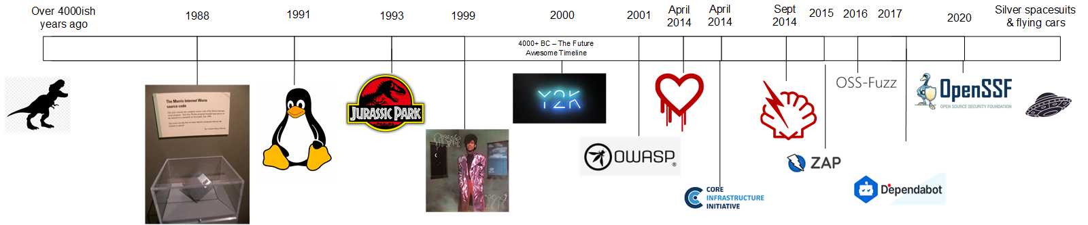

Timeline: Historical coordination toward securing OSS
Notes:
CR
Timeline
2014 Heartbleed
??
CII - Core Infra Initiative (now part of OpenSSF)
OSS-fuzz
2020 OSSC + JOSSI = OpenSSF

Slide 25

COORDINATED APPROACH - WHY AND HOW
Image - Eek!
Notes:
CR

Slide 26
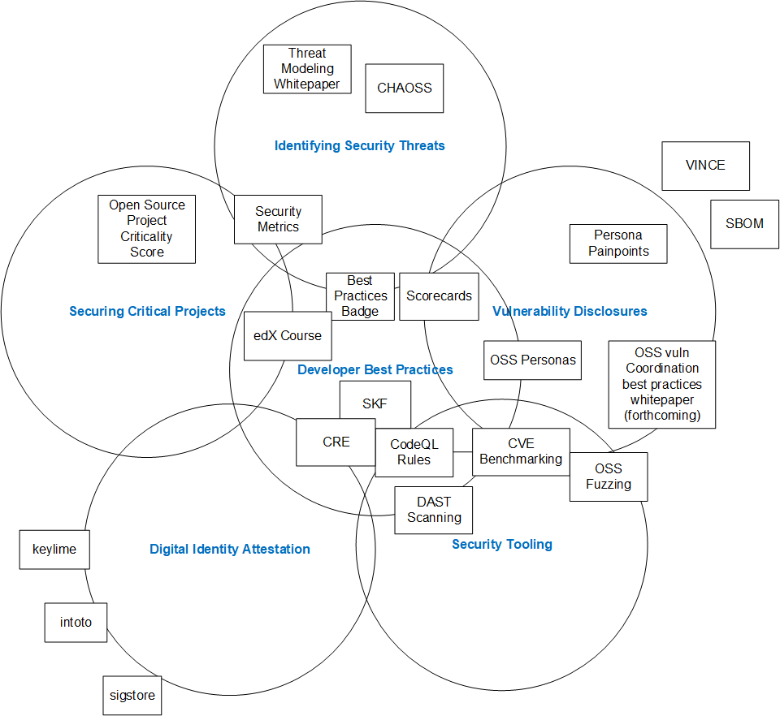

OPENSSF* Reference Architecture
(* The Open Source Security Foundation if you’re nasty)
Image - Miss Jackson
Notes:
CR What is OpenSSF and what are you trying to achieve?
The Open Source Security Foundation (OpenSSF) is an organization within the Linux Foundation that “brings together the industry’s most important open source security initiatives and the individuals and companies that support them.” NCC Group was a founding member of OpenSSF, alongside GitHub, Google, IBM, JPMorgan Chase, Microsoft, OWASP Foundation and Red Hat. This brought together a few different groups from across the industry, and also inherited the work of the Core Infrastructure Initiative (CII).
Essentially, the founders of this group recognized that securing the open source ecosystem required deep coordination and scalability. We need to all be pulling in the same direction. in my mind, OpenSSF is intended to be both the place where we debate and determine that shared direction, as well as where we incubate projects that can help.

Slide 27
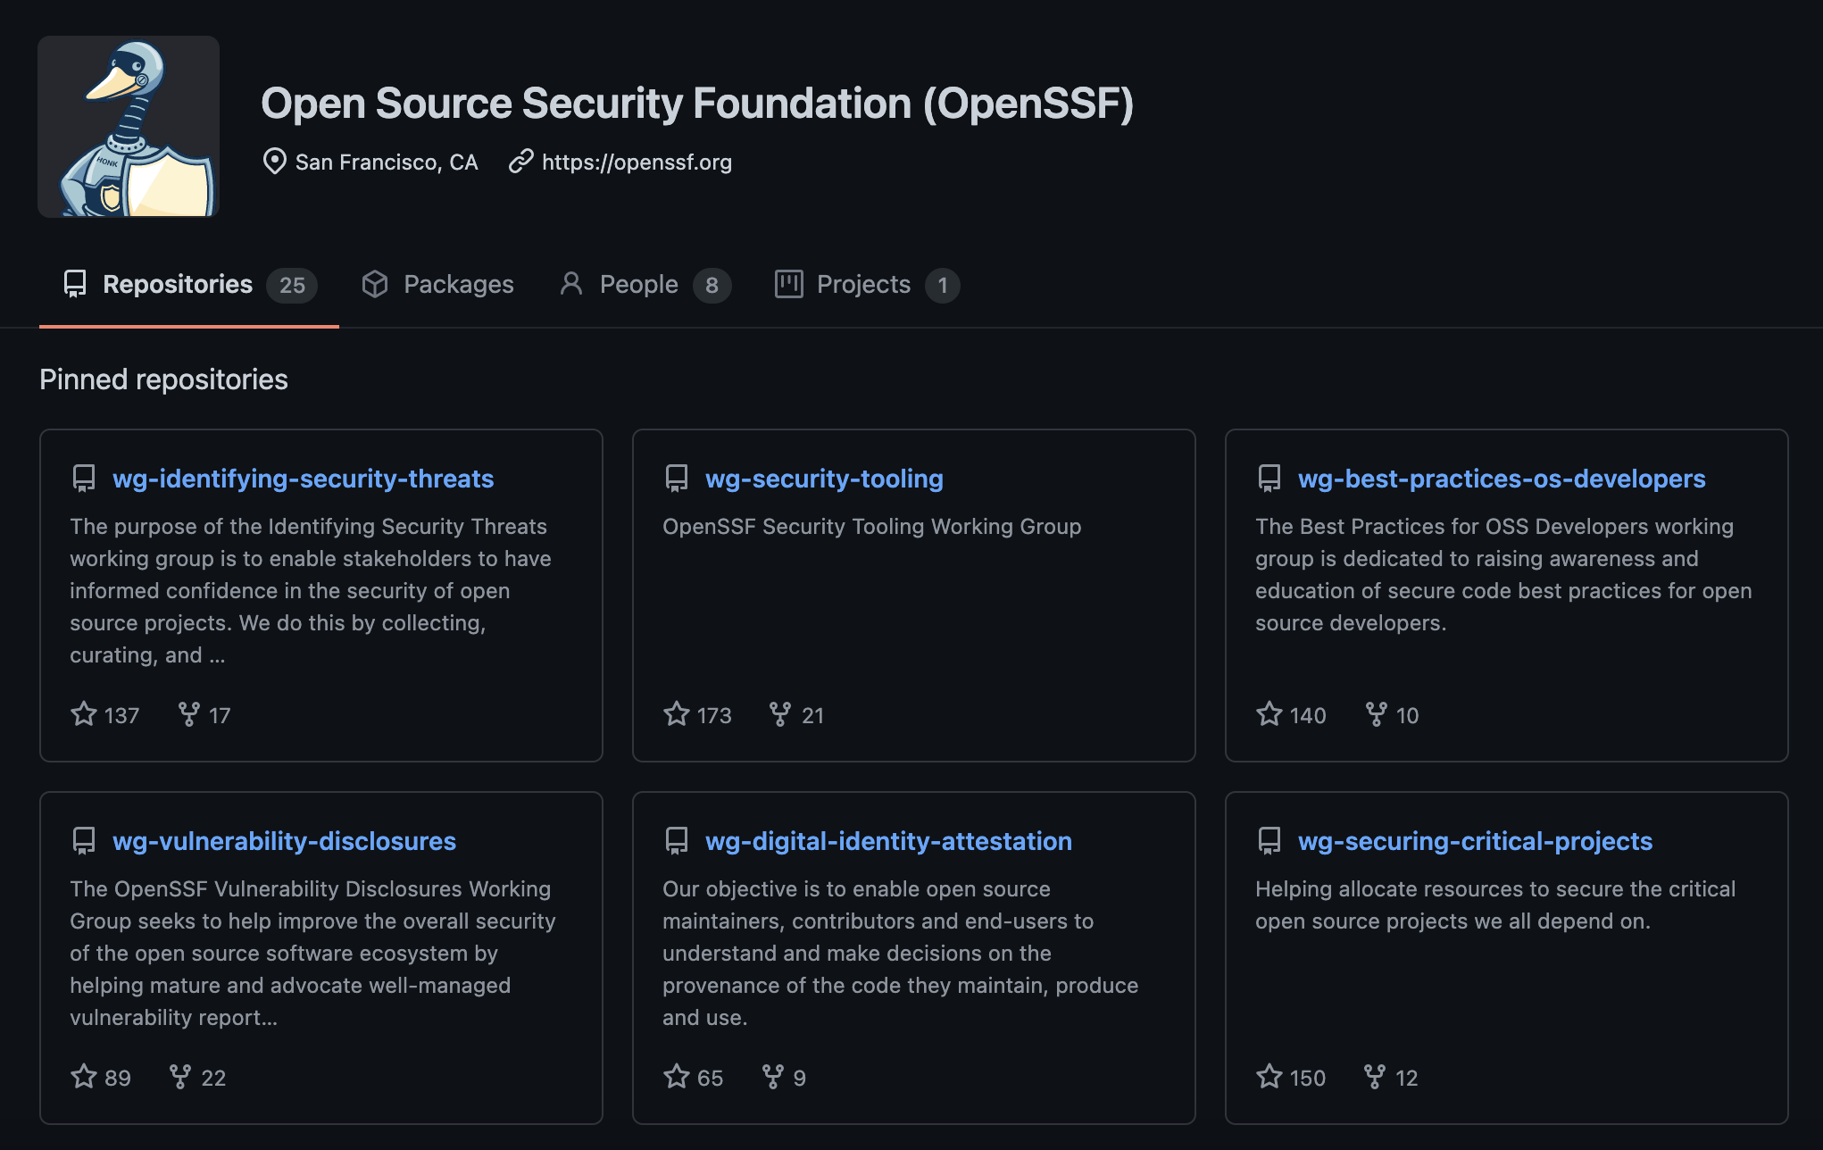

openssf.org/getinvolved
github.com/ossf
Notes:
Here is our github page
We currently have 6 working groups who are working on things like:
Building scalable tooling for OSS in general, including the development of “scorecards” to help users better understand the security properties of a given open source repo or package
Improving coordinated disclosure for OSS
Developing security guidelines for open source devs, combined with tooling like the CII Best Practice Badge to encourage projects to reach certain minimum security standards
Perhaps most interestingly, our securing critical projects group seeks to define the most critical projects on the internet for targeted investment of time and other resources for things like research, development of tooling, partial rewrites of code in safer programming languages, and third-party security audits.

Slide 28
Thank you!
openssf.org/getinvolved
github.com/ossf
@enjenneer
@SecurityCRob
#BHUSA @BlackHatEvents
Notes:
Thank you for listening. Please join us by visiting openssf.org/getinvolved
We will now share further details about our work, and take any questions.

Slide 29
Funding announcement:
OpenSSF Secure the Ecosystem Fund
To support security researchers & open source maintainers to improve the security of the open source ecosystem.
Applications accepted beginning Fall 2021
openssf.org/securityfund
Notes:
“This presentation will include the official launch announcement of Open Source Security Foundation's (openssf.org) grant program for security research projects to help secure the open source ecosystem!”
Simple statement for recording
Details in live Q+A before Q+A begins
Need summary, URL, go-live date

Slide 30
REFERENCES
Notes:
REFERENCES
(currently the below are statistical type reports; a second set of “further reading” refs on prominent tooling and other resources would be valuable)
Threats, Risks & Mitigations of the Open Source Ecosystem https://github.com/ossf/wg-identifying-security-threats/blob/main/publications/threats-risks-mitigations/v1.1/Threats%2C%20Risks%2C%20and%20Mitigations%20in%20the%20Open%20Source%20Ecosystem%20-%20v1.1.pdf
https://github.com/readme/featured/octoverse-security
Vulnerabilities in the Core https://www.coreinfrastructure.org/programs/census-program-ii/
Red Hat Product Security Risk Report
https://www.redhat.com/en/resources/product-security-risk-report-overview
https://www.gsma.com/security/wp-content/uploads/2020/12/Open-Source-Software-Security-Research-Summary-v1.1.pdf
https://www.whitesourcesoftware.com/resources/blog/2021-state-of-open-source-security-vulnerabilities-cheat-sheet/
https://www.synopsys.com/blogs/software-security/open-source-trends-ossra-report/
https://www.synopsys.com/software-integrity/resources/analyst-reports/open-source-security-risk-analysis.html
https://www.contrastsecurity.com/the-state-of-the-oss-report-2021
https://info.veracode.com/report-state-of-software-security-open-source-edition.html
https://itbrief.co.nz/story/veracode-soss-report-significant-open-source-security-gap-for-vendors-and-users
https://owasp.org/www-community/Free_for_Open_Source_Application_Security_Tools
https://betanews.com/2021/06/24/google-initiative-open-source-security-reporting/
https://venturebeat.com/2021/04/13/synopsys-84-of-codebases-contain-an-open-source-vulnerability/
https://itbrief.co.nz/story/veracode-soss-report-significant-open-source-security-gap-for-vendors-and-users
https://www.zdnet.com/article/google-releases-new-open-source-security-software-program-scorecards/
https://linuxinsider.com/story/stale-open-source-code-rampant-in-commercial-software-report-87150.html
https://joinup.ec.europa.eu/collection/open-source-observatory-osor/news/latest-report-security-and-sustainability-open-source
https://www.darkreading.com/application-security/open-source-developers-still-not-interested-in-secure-coding/d/d-id/1339654
https://www.linuxfoundation.org/resources/publications/improving-trust-and-security-in-open-source-projects/
https://securityboulevard.com/2020/06/open-source-sucks-says-ballsy-infosec-firm/
https://thenewstack.io/new-research-shows-secure-usage-of-open-source-remains-problematic/
https://risksense.com/press_release/open-source-software-security-vulnerabilities-doubled-in-2019-according-to-risksense-spotlight-report/

Slide 31
OpenSSF Grant Program
the Open Source Security Foundation’s new fund for for technical research to secure the open source ecosystem, where we will pay out hundreds of thousands to millions of dollars in grants annually. Attendees (and the general research community) will be able to apply for grants from us this summer and beyond for projects which help secure open source software.

Slide 32
@enjenneer
@SecurityCRob
Securing Open Source Software - End-to-end, At massive scale, Together
Jennifer Fernick - SVP & Global Head of Research, NCC Group
Christopher Robinson (CRob) - Director of Security Communications, Intel
August 5 2021
#BHUSA @BlackHatEvents
Notes:
Abstract Open source software is a significant part of the core infrastructure in most enterprises in most sectors around the world, and is foundational to the internet as we know it. Consequently, it represents a massive and profoundly valuable attack surface. Each year more lines of source code are created than ever before - and along with them, vulnerabilities. Consequently, we are minting vulnerabilities faster than our current techniques can discover and remediate them. We haven't yet seen the true potential of techniques for finding vulnerabilities at scale, and there are reasons to believe attackers may get there before we can.
The combination of distributed community-driven development, public-facing deobfuscated source code, inconsistent use of security reviews and tooling, and the prominence of many key FOSS projects as the core infrastructure of enterprises around the world and of the internet itself means that the unique model that has made open source software projects and development lifecycles so impactful is also that which has historically made them difficult to secure. These are the problems we were aiming to solve with the creation of the Open Source Security Foundation.
In this presentation, we’ll share key lessons learned in our experience coordinating the industry-wide remediation of some of the most impactful vulnerabilities ever disclosed (Heartbleed, Shellshock, Rowhammer, and BlueZ), present a threat model of the many unmitigated challenges to securing the open source ecosystem, share new data which illustrates just how fragile and interdependent the security our core infrastructure can be, debate the challenges to securing OSS at scale, and speak unspoken truths of coordinated disclosure and where it can fail. We will also discuss research advances that are making it easier for adversaries to find and exploit vulnerabilities at scale, and offer guidance for how members of the security community can get involved and contribute meaningfully to improving the security of OSS - especially through coordinated industry-wide efforts.
This presentation will include the official launch announcement of Open Source Security Foundation's (openssf.org) grant program for security research projects to help secure the open source ecosystem!

Slide 33
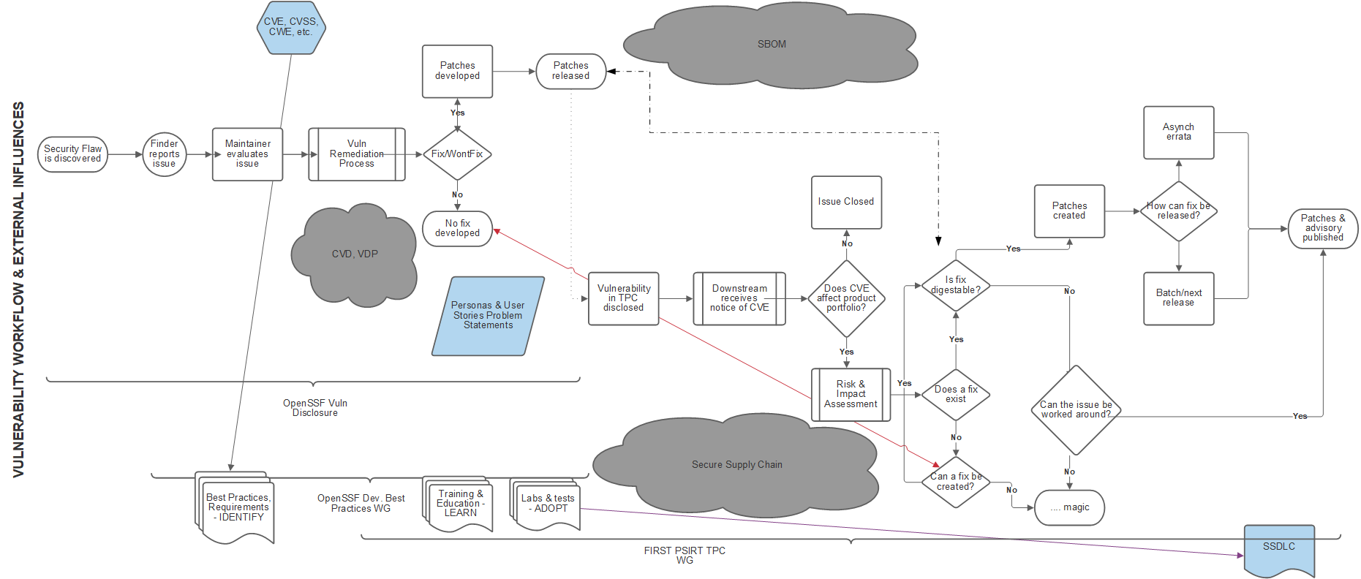
Notes:
JF/CR - both
This is a type of supply chain risk
The vast majority of vulns are just from mistakes - although some are deliberately malicious
But even mistakes can make dangerous code
“683 median transitive dependencies for npm followed by PHP (70), Ruby (68), and Python (19). All of which can become impacted by one security vulnerability.” (source: https://octoverse.github.com/#securing-software)
“Fernick recommends doing threat modeling before a single line of code is even written, and even thinking about security when deciding what development stack to use for a new endeavor. Meanwhile, established and new projects alike can take better advantage of automated tools for static analysis and fuzzing by integrating them into their CI/CD pipeline. “I think we have yet to see the true potential of techniques for finding vulnerabilities at scale,” Fernick says. “Large-scale fuzzing projects, vulnerability discovery query languages such as GitHub’s CodeQL, innovations in program analysis, applications of machine learning to identifying examples of particular bug classes, and recent research in automated exploit generation (AEG) have yet to, in my opinion, become fully realized, and are likely to shift the security landscape.”” (source: https://github.com/readme/featured/octoverse-security)

Slide 34
Agenda
Hello world!
The Security of OSS
Coordinated Disclosure
Threat Modeling OSS
What ACTUALLY helps secure OSS
The Next Few Years
Q&A

Slide 35

Imagine a world…..
Image - minions

Slide 36
Jennifer Fernick
SVP & Global Head of Research at NCC Group
Co-founding Board/TAC member for Open Source Security Foundation
Cryptographer, standards dev’t, quantum computers
CRob, n, adj, and v
Pronunciation: U.S. (K-robe)
Over 25 years of Enterprise-class Architecture, Engineering, Operations, and Security experience
Ambassador For Intel Product Assurance and Security
Working Group lead for the OpenSSF Dev Best Practices & Vuln Coordination WGs, FIRST PSIRT TPC WG, and others
Co-Author FIRST PSIRT Services Framework & others
Pirate-enthusiast & hat-owner

Slide 37
We can’t forget about our bestest OSS-buddies
Kay
Rao

Slide 38
The Security of OSS = The Security of EVERYTHING

Slide 39
Problem Overview
It has been estimated that FOSS constitutes 80-90% of any given piece of modern software ⁽¹⁾
One report found that 84% of these codebases had at least one vulnerability, with the average having 158 per codebase ⁽²⁾
Other reports discover that average applications contain 118 libraries with roughly ⅓ being active; The average library age was 2.6 years old ⁽³⁾
Over a 10 year period the volume of vulns has increased over 4 times [as measured with CVE] ⁽⁴⁾
Most OSS vulns are discover in indirect dependencies ⁽⁵⁾
A typical vuln can go undetected for 218 weeks, and typically takes 4 weeks to get resolved once the project is alerted to it ⁽⁶⁾
(1) - State of the Software Supply Chain
(2) - 2021 Open Source Security and Risk Analysis Report
(3) - 2021 State of Open Source Security Report
(4) - 2020 Red Hat Risk Report
(5) - 2020 State of Open Source Security Report
(6) - 2020 State of the Octoverse

Slide 40
CVE-2014-0160
https://heartbleed.com/
Vulnerability in popular open source library OpenSSL that could leak sensitive information otherwise thought protected by SSL/TLS encryption
This is a widely-used method to protect communications over TCP-IP-based networks (example - The Internet)
”At the time of disclosure, some 17% (around half a million) of the Internet's secure web servers certified by trusted authorities were believed to be vulnerable to the attack, allowing theft of the servers' private keys and users' session cookies and passwords” ⁽⁷⁾
Public disclosure - 7 April 2014
Exposure -
21 June 2014 - 309,197 public web servers remained vulnerable ⁽⁸⁾
6 July 2017, the number had dropped to 144,000 ⁽⁹⁾
11 July 2019, 91,063 devices were vulnerable ⁽¹⁰⁾
(7) - Heartbleed
(8) - 300k vulnerable to Heartbleed two months later
(9) - Heartbleed’s Heartburn: Why a 5 year Old Vulnerability Continues to Bite
(10) - Heartbleed Report
At the time, OpenSSL had TWO full-time developers to develop, maintain, test, and review 500,000 lines of code ⁽⁷⁾

Slide 41

Securing OSS =
OSS is created by people around the globe, with different skills, backgrounds, and motivations
OSS rarely comes from ONE creator, and is a blending on voices and ideas working to a common goal (that might not be YOUR specific goal)
OSS moves fast (“industry standard” time to merge pull request - 1hr 36min) ⁽¹¹⁾
“Interesting” Problem Set
(11) - 2020 State of the Octoverse
Image - Batman Interesting

Slide 42


UNIQUE CHALLENGES
Many of the best things about open source development invite unique security challenges to overcome:
Public-facing source code - no need for attackers to RE the binaries
Distributed community-driven development, including from unknown third-parties
At times, a “tragedy of the commons” - just because someone COULD have reviewed the code doesn’t mean they HAVE
Lack of consistently-deployed standards and lack of consistently-used tools for even basic vuln reduction
Many projects are incapable of writing patches or handling disclosure or incident response
Little to no economic incentive or feedback loop for security
But in spite of all of this, these projects are high-value targets that are foundational to many of the technologies that power our world and to the internet itself.
Image - Fine
Image - NewFine

Slide 43

HOW IS THAT PROBLEM EVEN A THING?
Transitive dependencies - the risks that the dependencies of your dependencies introduce to your project
(12) - OWASP Dependency Management Cheat Sheet
(13) - Synk - 78% of vulnerabilities are found in indirect dependencies, making remediation complex
Image - Aliens

Slide 44
Some questions to ask when trying to report an issue to an OSS project
Does the project use Coordinated Vulnerability Disclosure?
Who do you report an issue to?
Does the project have the capability to take a private security report?
Does the project have any security-trained/able developers to understand the report?
Who on the project has access these reports?
Who/What is silently observing commits/communications of the project?
What are the rules of the community around disclosure?
How do you KNOW all the right downstream consumers got notified?

Slide 45
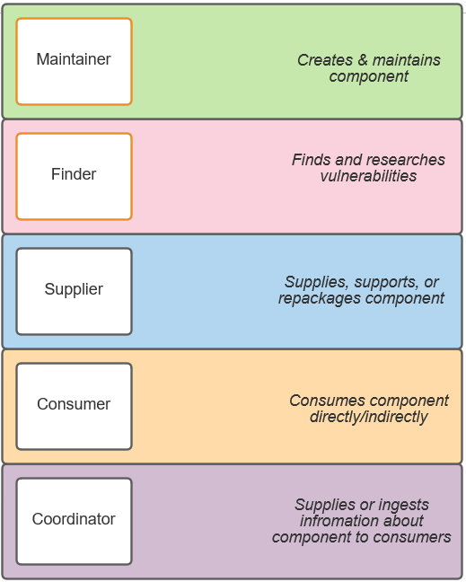
OpenSSF Vulnerability Disclosure Working Group
OSS Personas & Persona pain-points informing future WG work to try and ease
Working with CERT-CC & others to open source VINCE Vuln reporting tool
Developing standardized templates for projects for security policy, vuln intake, & others

Slide 46
COORDINATED VULNERABILITY DISCLOSURE
Discussion of incident response and lessons learned during the coordinated multi-party disclosures for Meltdown/Spectre
Discussion of real-life examples of:
when vendor conflicts of interest have gotten in the way of remediating critical vulnerabilities in key pieces of open source software
offering incident response to tiny open source projects with critical vulnerabilities at the core of the internet
patching vulnerabilities in plain view of those who seek to exploit them
and more!
Advocacy for what specifically needs to change in the opaque, unwritten rules of the vulnerability disclosure landscape to better mitigate risks

Slide 47
Threat Modeling & the OSS ecosystem

Slide 48
Security is more than just vulnerabilities in source code
Open Source SDLC?
Developer identity and authentication
Preventing compromise of developers’ local dev environments
Abuse of debug privileges and development-related backdoors by threat actors, and other abuses by external contributors
Introduction of insecure code through resources like StackOverflow
Secrets mismanagement by developers/maintainers
Build pipelines and verification, including work around reproducible builds and binary transparency
Verifying commits
Preventing and detecting compromises to package managers/repositories

Slide 49
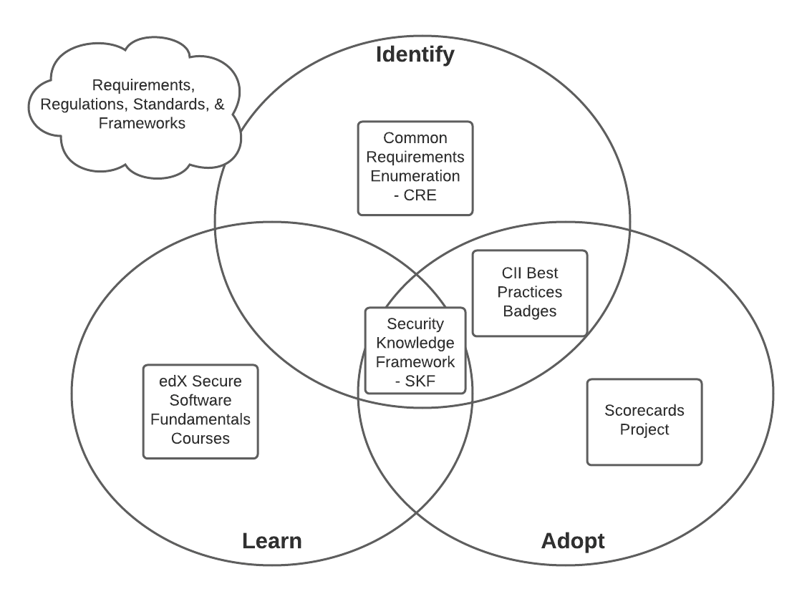
OpenSSF Developer Best Practices Working Group
Tools, Training, & measurements to help OSS projects code more securely

Slide 50
OpenSSF Identifying Security Threats in Open Source Projects Working Group

Slide 51

OpenSSF Digital Identify Attestation Working Group

Slide 52
What ACTUALLY helps secure OSS

Slide 53
“Groundbreaking” idea
If you use software from a project, maybe you could contribute back to that project?

Slide 54
slide
Threat modeling to understand the many places and points in time at which a project can be compromised.
Identifying the most critical open source projects - even if these aren’t always the obvious projects - to help prioritize the allocation of resources toward these widely-deployed, high-impact codebases.
Preventing vulnerabilities through safe(r) programming languages, developer education programs, and useable and free program analysis tooling
Preventing inherited security debt through tools that can help developers obtain and users assess the security of a project (such as the CII Best Practices badge)
Tool development to scalably find as many vulnerabilities as possible in a codebase in a repeatable and automated way, and integrating this into build pipelines.
Coordinated patching and incident response support to respond to high-impact vulnerabilities in open source software
Better vulnerability disclosure processes, response, and workflows with OSS maintainers

Slide 55
Openssf blah blah blah plus tax

Slide 56
The Next few years...

Slide 57
What concerns you most about securing the open source ecosystem?
The number of vulnerabilities “in the wild” outpaces the speed at which the security community can patch or even identify them. And each day, the world contains more lines of source code than it ever has before. Consequently, the [generally inadvertent] creation of potentially exploitable vulnerabilities increasingly outpaces the rate at which we can search for and remediate them, and this problem is one that only gets worse with time.
I think we have yet to see the true potential of techniques for finding vulnerabilities at scale. What’s simultaneously exciting and terrifying is that the technologies that can be used to hunt vulnerabilities at scale are dual use in nature - they can be used by the defenders, or they can be used by our adversaries - and our adversaries only have to get it “right” once.
Scaling of attacker capabilities - large scale fuzzing projects, vulnerability discovery query languages such as CodeQL, innovations in program analysis, applications of machine learning to identifying examples of particular bug classes are all methods by which attackers will potentially be able to scale attacks faster than we can scale patching.
This concern is compounded by the Automated Exploit Generation (AEG) literature, which is showing that even small, poorly-incentivized academic research has made progress in automating the chaining of attack chains
Findings in large language models like GPT-3 which show that large language models are particularly good at learning from a corpus of internet text - including code - and generating novel code based on user input (Note: at time of BH CFP submission, the research involving large language models is not yet public)
Need for quantum-resistant code signing - otherwise, secure/verified software updates after the advent of large-scale quantum computer are impossible

Slide 58
OpenSSF Grant Program
the Open Source Security Foundation’s new fund for for technical research to secure the open source ecosystem, where we will pay out hundreds of thousands to millions of dollars in grants annually. Attendees (and the general research community) will be able to apply for grants from us this summer and beyond for projects which help secure open source software.

Slide 59
Get Involved
More details: https://openssf.org/getinvolved
Individuals
Join a Technical Working Group - https://github.com/ossf
Join the Mailing List - subscribe to the openssf-announcements mailing list
Join our Public Meetings - http://bit.ly/ossf-calendar
Join our Slack Channel - https://slack.openssf.org
Watch YouTube Channel - http://bit.ly/ossf-youtube
Organizations
Become a Corporate Member

Slide 60
Q&A
#BHUSA @BlackHatEvents

Slide 61
Thank You!!
#BHUSA @BlackHatEvents

